Slide 1
P2P Cloud Computing Sharing Platform
Members:
Zongshuo Wei
Chengchen Zhao
Lingrui Li
Jiyuan Xia
Hanyu Wang

Slide 2
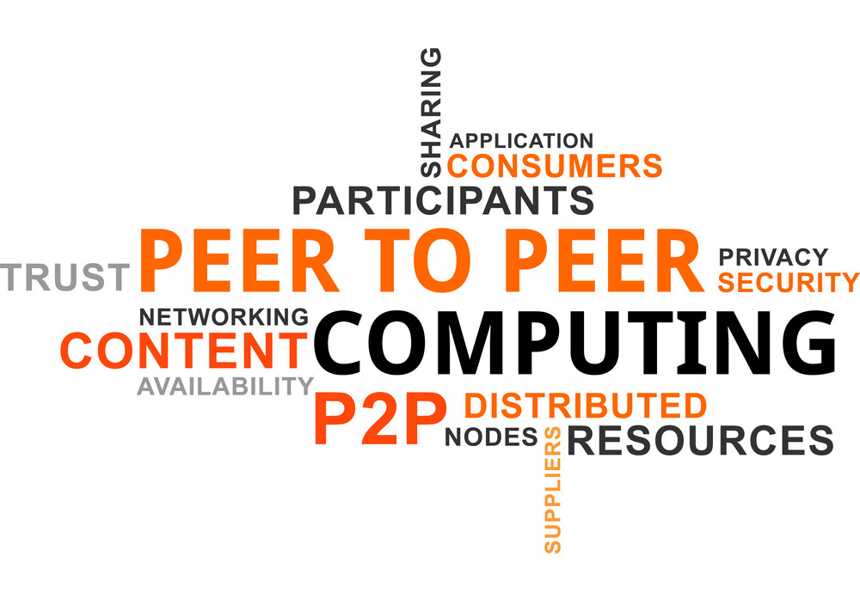
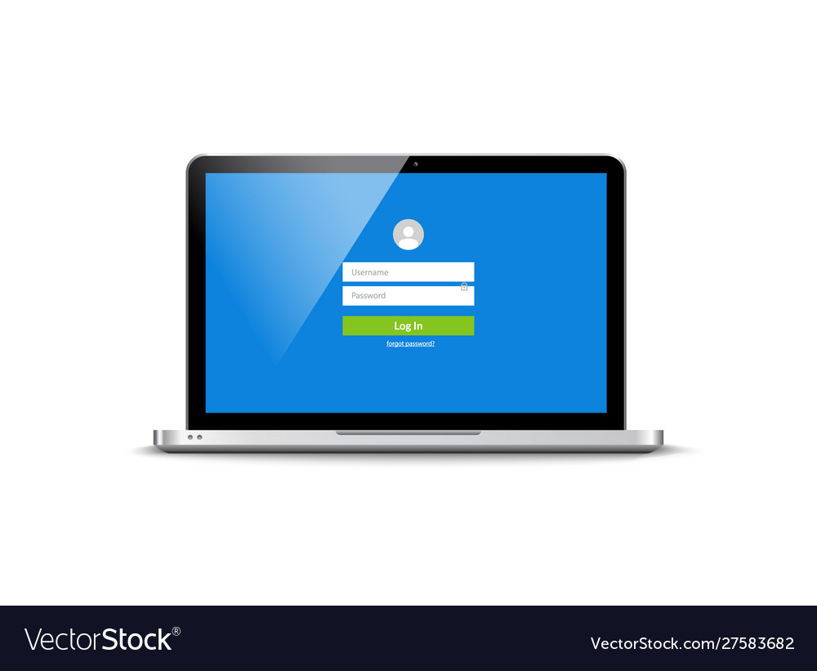
Project Description
Notes:
This website aims to provide p2p service through the traditional form of a shopping website to allow users to lease their idle computing resource to customers who are in need, which is unlike popular laas cloud computing providers.
Basically, P2P Cloud Computing is a decentralized variant of the traditional cloud computing model that offers its users the ability to share resources with each other, in such a way that at least IaaS is preserved. In our case, from Iaas to SaaS will all be supported by registered service providers.
Unlike Community Clouds — where vendors agree to share their resources on single multi-tenant cloud infrastructure, and unlike Edge Computing — a paradigm that prioritizes exporting computing power out of the cloud infrastructure and closer to the point where it’s needed; P2P Cloud Computing defines a state where Cloud Consumers and Cloud Providers are the same entity.
connectivity and compute resources offered on-demand when and where needed
Example: SETI@home (Berkeley Open Infrastructure for Network Computing)

Slide 3
Target Users
01
Business
Server
Data Science
3D/ Video Rendering
02
Institution
Research
Scientific Computing
Deep Learning
03
Individual
Gaming
Video Editing
Notes:
When it comes to our target users, it basically consists of three aspects, business, institutions and individuals. For business use, our products can help users find suitable and ideal servers for data analysis or 3D video rendering, which usually require extremely high equipment configurations and are not easily available for users themselves. For academic research purposes, institution can get servers through our website to conduct the research like scientific calculation, deep learning and computer vision research, etc. Not only that, but we can also serve the public. For example, a video game fan is struggling because his personal device doesn’t meet the minimum system requirements. Then he can get a virtual server and enjoy the game by connecting to it.
In a nutshell, our product has a wide variety of direct and potential users.

Slide 4
Our Solution VS Competitors
Strengths
Weaknesses
Decentralized
Flexibility
Free market
Trust issue
Reliability
SWOT
Opportunities
Threats
6G and beyond
Blockchain and crypto
Regulation
Security
Competition
Notes:
“centralization process” of our internet since last decade.
NSO servers shut down by AWS
https://www.vice.com/en/article/xgx5bw/amazon-aws-shuts-down-nso-group-infrastructure
Data traffic has to travel hundreds of miles to get to an interconnect point.
6G & Starlink faster connection and more coverage
Blockchain technology

Slide 5
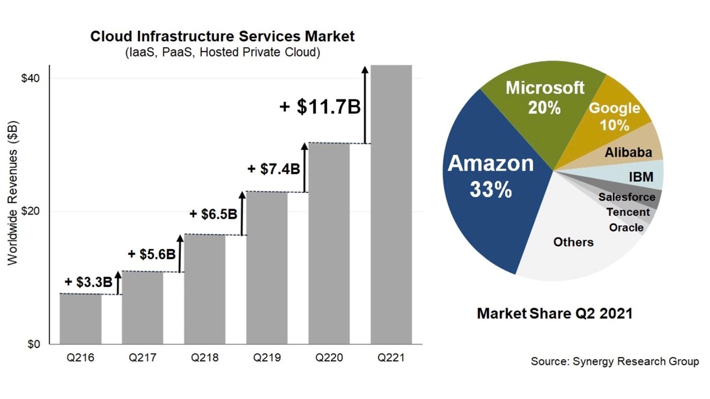
Business Value
Cloud infrastructure services market was worth $42 billion in Q2 2021
Year-on-year growth of 39%
In the 12 months till Q2 2021, the market generated sales of $152 billion
Non-profit organization OGA (Open Grid Alliance) was formed in April 2021
Notes:
Cloud infrastructure services market was worth $42 billion in the second quarter, reports Synergy Research
Year-on-year growth of 39%
In the 12 months to the end of June, the market generated sales of $152 billion
“Co-locating” of high-speed trading firms. 21 milliseconds off per trade. Several academic studies have found that shaving even one millisecond off every trade can be worth $100 million a year to a large, high-speed trading firm.
Low cost: Our platform does not run any servers & computers except the one that hosts the website itself. And during 1st stage, major data traffic is through third party (teamviewer in this case). All the investment will go to technology development and marketing.
"The OGA aims to rearchitect the Internet from the communications hub that currently exists, to a global, shared platform that distributes compute, data, and intelligence to where it’s needed, when applications and services demand it, and with guarantees and SLAs. In short, the OGA aims to lay the digital foundation for a better world." has 31 members in total including VMWare, Dell Technology, T-mobile…

